Slide 1
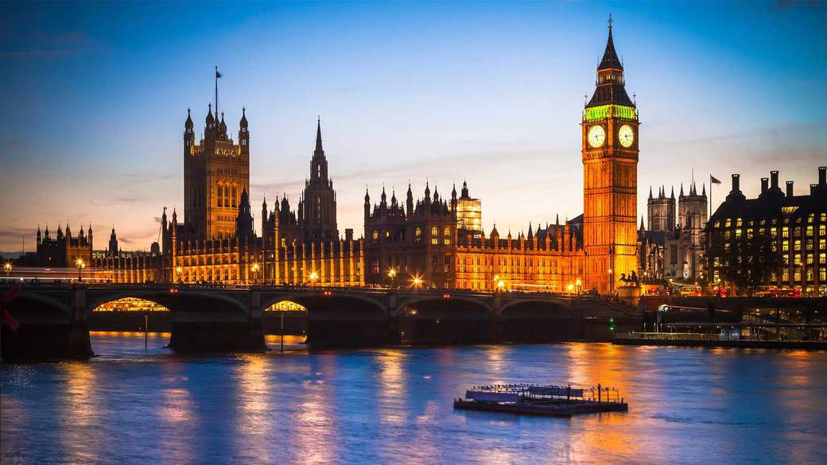

Slide 2
YOU MUST SEE:
The London Eye is a distinctive element of the London skyline. It is the highest Ferris wheel in the world, with 32 capsules of 10 tons each that can hold up to 25 people. Climb aboard for a breathtaking experience, with unforgettable views of over 50 of London's most famous monuments: and all in just 30 minutes!
Buckingham Palace, one of the few inhabited royal palaces in the world. During the summer, you can explore the splendid State Rooms of the Queen's official London residence and admire the annual special exhibition
Madame Tussauds, one of the most famous wax museums in the world, will come face to face with some of the most famous faces in the world. From Shakespeare to Lady Gaga, you will meet influential personalities of entertainment, sports, politics and even the English royal family. You can pose with Usain Bolt, kiss Brad Pitt or, once in your life, be received in audience by His Majesty the Queen.
Tower of London, one of the most famous and mysterious buildings in the capital. Discover its 900 years of history as a royal palace, arsenal, prison, place of capital executions, home of the crown jewels ... and zoos! Among the not-to-be-missed things, the White Tower, the crown jewels and the bed rooms of medieval kings and queens.

Slide 3
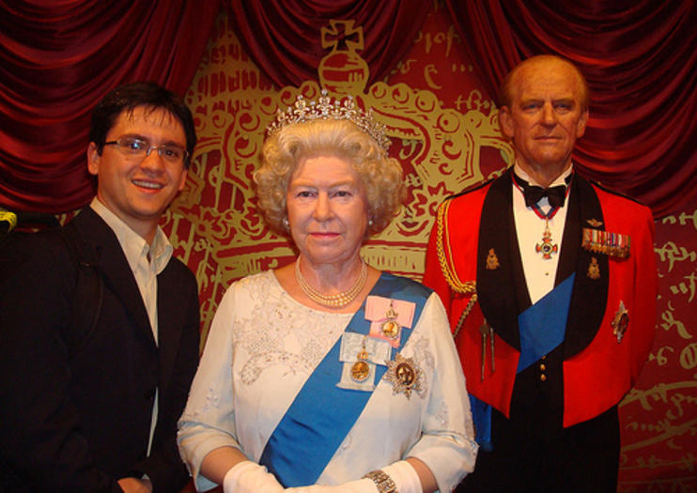
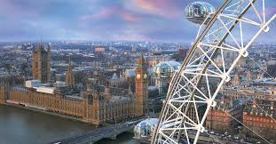
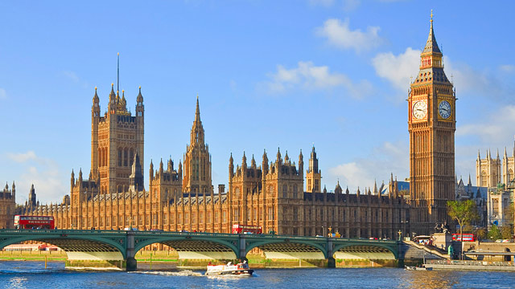
GFTI
Westminster Abbey, one of the most beautiful and famous churches in London. Visited every year by more than a million visitors, Westminster Abbey is a masterpiece of Gothic architecture, whose construction began under King Henry VIII, who chose it as his burial site
-
Shard, the tallest skyscraper in Western Europe, designed by the Italian architect Renzo Piano, and enjoy the spectacular view of the city of London and its monuments. At over 240 meters high, The View From The Shard is by far the highest vantage point in the city, and the only place from which to enjoy a 360 degree view
-Chelsea FC, Chelsea's London stadium, and discover all its secrets with this unmissable guided tour. From the dressing rooms to the press room, passing by the benches and the sidelines, enjoy in exclusive behind the scenes of one of the world's sports meccas

Slide 4
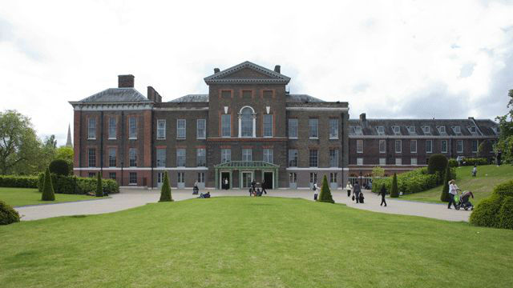
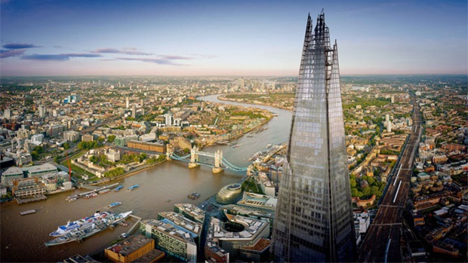
HJU
-Kensington Palace is the current home of the Queen's nephew and his wife, the Duke and Duchess of Cambridge (William and Kate). Explore the spectacular halls of the building and visit the temporary exhibitions dedicated to the past and present of the English royal family.
-Explore the beautiful St Paul's Cathedral and discover its secrets with a guided tour Admire the cathedral's art masterpieces and monuments dedicated to some of the greatest national heroes, such as Admiral Lord Nelson and the Duke of Wellington. Take a ride in the crypts, and go up to the Golden Gallery, which offers breathtaking panoramic views of London

