Slide 1
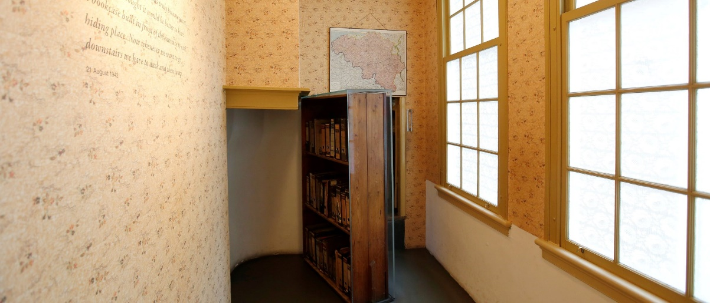
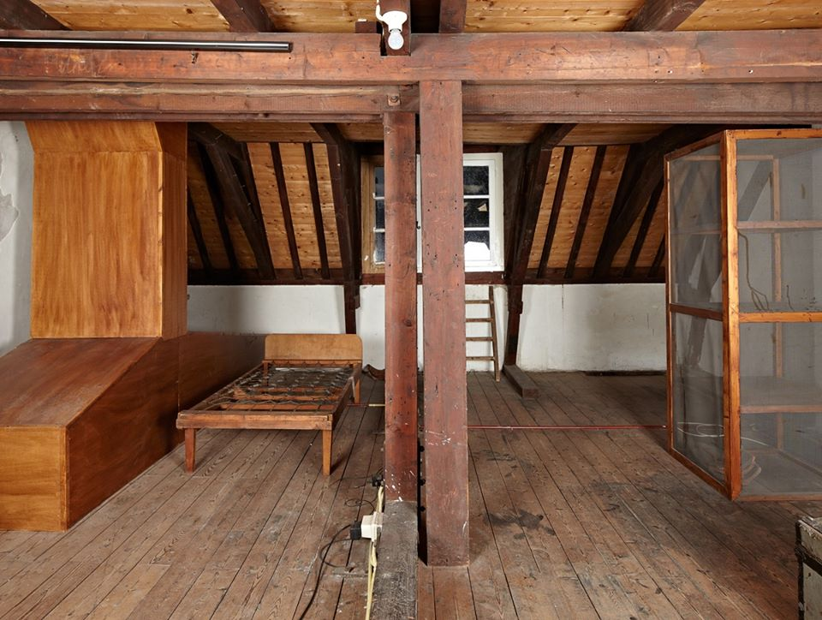
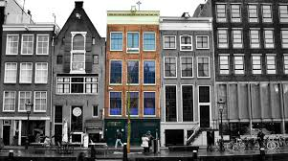
The story of Anne Frank & Oscar Schindler

Slide 2
DAY 1: fly to Amsterdam where you will be met by our representative and transferred to you hotel for a overnight ​DAY 2: Visit Anne Frank's House link-https://www.annefrank.org/en/ Information about the museum Practical information Read more about the museum’s accessibility, the cloakroom, audio tours, the museum café, the museum shop, photography, and our Terms and Conditions for Visitors. Inside the museum The Anne Frank House is a museum with a story. As a visitor, you experience this story through quotes, photos, videos, and original items. Group visits Read more about visiting the museum with a group or a school class. Collection and research Read more about collection management and conservation and about our historical research, and browse through the stories behind the items in our collection. Renewal The Anne Frank House is ready for a new generation. Frequently Asked Questions Find the answers to your questions about buying tickets and visiting the museum.

